Slide 1
Sarcasm detection using deep learning and ensemble learning
Name: Md. Shamsul Rayhan Chy
ID: 19201109

Slide 2
Purpose of this Paper
To minimize the gap between human and machine intelligence to recognize and understand sarcastic behavior and patterns.
The target is to quantify the overall sentiment as positive/negative sarcastic or non-sarcastic.
Check if the correct message is received to the intended audience or not.

Slide 3
What is Sarcasm?
Sarcasm is a characteristic sentiment where feelings are expressed.
It can be expressed with positive or non-positive words.
For interpreting the sarcastic content correctly one need to ignore the contextual sense of a text and rather understand the naturally inverse sense.

Slide 4
Importance of Sarcasm Detection
Sarcasm detection can improve the engagement of sentiment analysis.
To deliver the perfect message of a sarcastic text, it need to precisely decide the accuracy of statements.
Failure of sarcastic detection may abolish the purpose of any kind of message.

Slide 5
Used Model Characteristics
The model is an ensemble model made from Baseline CNN, bi-directional LSTM and GRU which can learn sarcastic patterns and provide improve accuracy.
Model has been pre-trained word embedding models like Word2Vec, GloVe and fastText.
This model is flexible and accurate.
Model has been trained and validate on two publicly available datasets.

Slide 6
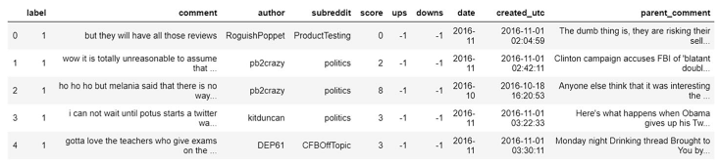
Used Dataset Description
Two datasets is used in this paper.
The news headlines dataset is used to detect sarcasm.
It is taken from two prime news websites named the Onion and the HuffPost.
Second dataset was produced by scraping a large set of comments from Reddit which comprises sarcastic comments from Internet commentary.
Fig: Snippet of sarcastic comments in Sarcasm on Reddit Dataset

Slide 7
Methodology : Preprocessing
This study uses an ensemble model along with word embeddings.
Data preprocessing is done to modify the raw dataset into a comprehensible format.
Natural language toolkit (NLTK) has been used prior to the training stage for preprocessing both the datasets.
Concatenation of content, elimination of duplicate text, employment of tokenization were done to preprocess the datasets.
Non-essential content were replaced then.

Slide 8
Methodology: Word embeddings
Here, the categorization of similar words together takes place.
Word embeddings add contextual meaning to the words that have been selected and would be vectorized.
Word2vec, GloVe and fastText word embedding methods are used here.
Token vectorization of the word is accomplished by using the above embedding techniques.
Presence of sarcasm is encoded through binary digit where 1 represents sarcasm is present and 0 the vice versa.
Word embedding predicts new text data based on previous training data.

Slide 9
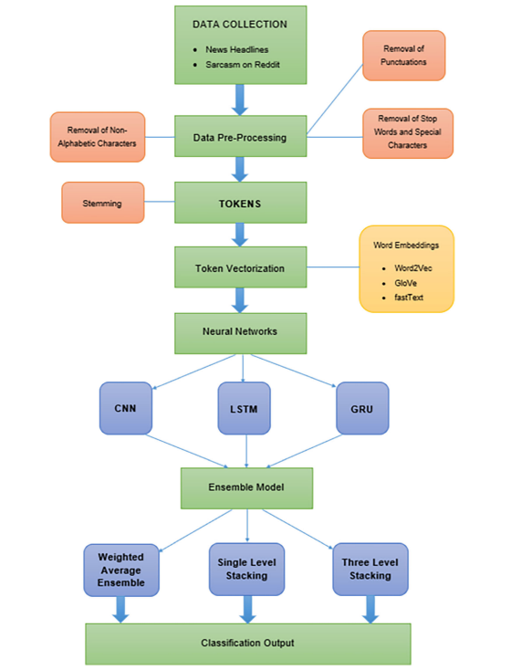
Methodology: Flow Chart

Slide 10
Methodology: Deep Learning Networks
Deep learning techniques such as CNN, LSTM, and GRU are comprised in this study.
Here, CNN is applied on the content to model learnt, extracted features and detected patterns and 5 layers has been used here.
In this, 300 LSTM cells were applied with a single layer of LSTM. Four individual and independent calculations were carried out with the help of four gates for each cell.
GRU is used to make connection through a series of nodes to execute machine learning tasks related with memory and clustering like in text identification.

Slide 11
Methodology: Proposed Model-Ensemble Learning
Ensemble model is used in this study to make this proposed model.
Usually ensemble method produces more accurate solutions than single model.
Every model in ensemble has its own contribution.
Deepstack library is used to ensemble three pre-trained models.
Here, every of 3 pre-trained models gets trained individually at first and then the embedded ensemble model is trained.
These are Single level stacking and Three level stacking.

Slide 12
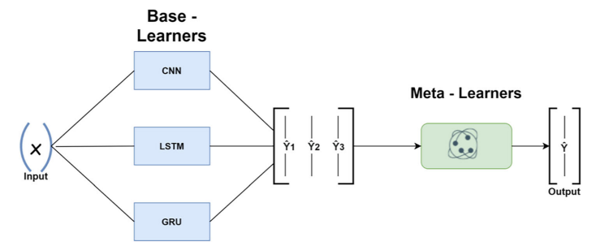
Methodology: Proposed Model-Ensemble Learning
Single Level Stacking:
Stacking is based on training a Meta-Learner on top of pre-trained Base-Learners.
Scikit-learn library is used to create a single level stacking model.
Output from base learners is used to provide input to the meta-learner.
Fig: Single level stacking ensemble model

Slide 13
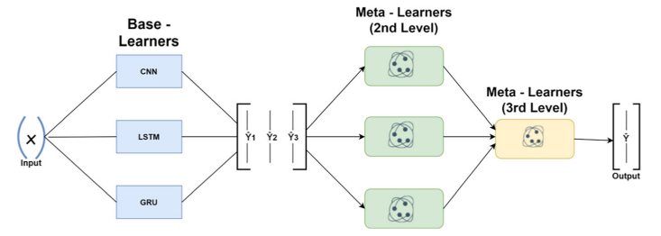
Methodology: Proposed Model-Ensemble Learning
Three Level Stacking:
Scikit-learn Stacking interface is used to create a 3rd level meta-learner.
DeepStack was utilized in order to achieve a more powerful model than single level stacking.
Fig: Three level stacking ensemble model

Slide 14
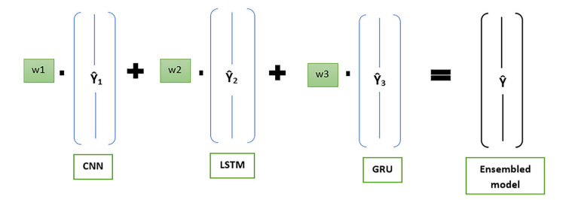
Methodology: Weighted Average Ensemble
Weighted Average Ensemble Technique weights the prediction of each ensemble member and then combine them to calculate a combined prediction.
There is no meta-learner used in this ensemble.
Fig: Weighted average ensemble model

Slide 15
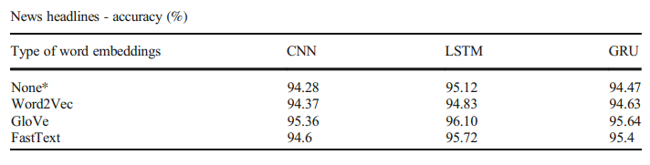
Result Analysis: News Headline Dataset
The ensemble model used has tried to bring down the gap between learning of unique and temporal highlights of the textual information.
The model has been trained using Sigmoid as the activation function and Adam as the optimizer with dropouts of 0.15, 0.25 and 0.35 respectively.
The model has been executed for 30 epochs having a batch size of 64.
Fig: News Headlines dataset pretrained model accuray

Slide 16
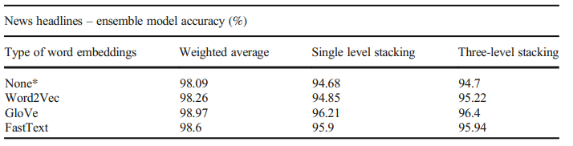
Result Analysis: News Headline Dataset
Fig: News headlines dataset ensemble models accuracy
Ensemble model with Glove word embedding has performed the best when compared to other word embeddings and has achieved an accuracy of 98.97%.
LSTM technique has obtained an elevated accuracy as compared to the CNN and GRU models with or without word embeddings.

Slide 17
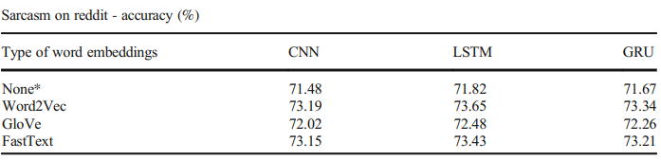
Result Analysis: Reddit Dataset
The model has been executed for 10 epochs having a batch size of 128.
Without word embeddings, accuracy obtained for CNN, LSTM and GRU model is 71.48%, 71.82% and 71.67% respectively.
With word embeddings, Word2Vec performed the best with accuracy obtained as 73.19%, 73.65% and 73.34% respectively.
Fig: Sarcasm accuracy on reddit dataset

Slide 18
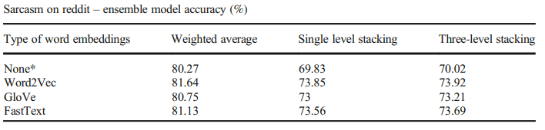
Result Analysis: Reddit Dataset
Ensemble model with Word2Vec word embedding has performed the best with 81.64% accuracy while the single-level stacking and three-level tacking has the values as 73.85% and 73.92% and respectively.
Also, the LSTM technique has obtained an elevated accuracy percentage than the CNN and GRU models with or without word embeddings.
Fig: Sarcasm accuracy on reddit dataset ensemble models

Slide 19
Conclusion
There is a significant improvement in employing word embeddings as compared to the ensemble accuracies.
Without these embeddings, the study concluded that the best performing model was LSTM.
Among ensemble models, the Weighted average with Glove word embedding came out to be best with 98.97% accuracy.
The best accuracy for the ensemble model without word embeddings came out to be 98.09% and 80.27% for both the datasets respectively from Weighted average.
So, overall the weighted average ensemble model has achieved more accuracy when compared to other models.

